Slide 1

Nursing Tech
Exploring websites, applications and programs for student success.

Slide 2
There are several sites for information dissemination
Explore what works for you.
Try new things. There may be a learning curve, so give yourself time.
There's plenty out there, so if it doesn't work, try something else.
Read reviews, watch a YouTube video, participate in discussion boards.
Ask other peers about their experience.
Look at rankings.
Ask AI
Ask a younger person!

Slide 3
Breakdown by type
 | Website | App | AI
Access | Through a browser | Requires downloading and installation | Both
Nature | Providing information | Designed for specific tasks | Enhances functionality personalization and user experience
Interactivity | Can be interactive, but less so than apps | Generally, more interactive and can leverage device features | AI algorithms analyze user behavior to personalize content and leads to increased engagement and conversions
Website
App
Artificial Intelligence (AI)

Slide 4
Tools to improve efficiency, enhancing learning and improving patient care
Learning
Studying
Instant Answers
Textbooks
Test Prep
Notes
Transcription
Anatomy / Physiology
Flash Cards
Clinical Practice
Scheduling
Patient Care
Mnemonics
Research
Care Plans
Guidelines
Drug Information
Predictive Analytics

Slide 5
Professional Nursing Organizations
Too many to list! A sampling of some popular ones.

Slide 6
Professional Nursing Organizations
American Nurses Association (ANA) http://www.nursingworld.org
National League for Nursing (NLN) http://www.nln.org
American Association of Critical Care Nurses http://www.aacn.org
National Council of State Boards of Nursing (NCSBN) http://www.ncsbn.org
American Association for Men in Nursing (AAMN) http://www.aamn.org
American Holistic Nurses Association (AHNA) http://www.ahna.org
Emergency Nurses Association (ENA) http://www.ena.org
Sigma Theta Tau International Honor Society of Nursing http://www.sigmanursing.org
American Association of Colleges of Nursing (AACN) http://www.aacnnursing.org

Slide 7
Continuing education, Jobs & News
Nurse.com: a leading resource for nurses, offering continuing education courses, jobs, news, and career resources.
Nursingcenter.com: provides access to articles from leading nursing journals, CE activities, job opportunities, and other resources.
Allnurses.com: a forum-based website offering support, information exchange, and job postings for nurses and nursing students

Slide 8
Government & Health Resources

Slide 9
Government & Health Resources
CDC.gov Centers for Disease control and prevention: a reliable source for information on disease prevention and health promotion relevant to nursing practice.
Nih.gov National Institutes of Health offers rich information on various consumer health topics.
California Board of Registered Nursing: A great site for all your licensure, news alerts, continuing education and much more.
US Bureau of Labor statistics: job outlook, pay details, occupation finder.

Slide 10
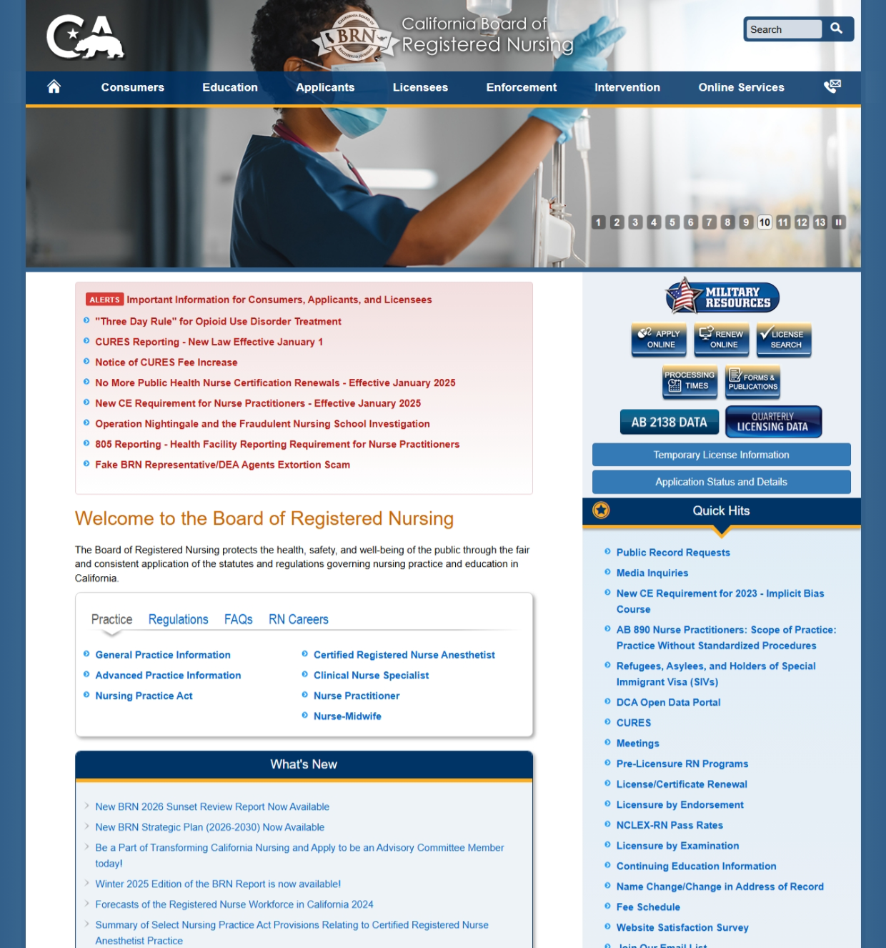
California Board of Registered Nursing

Slide 11

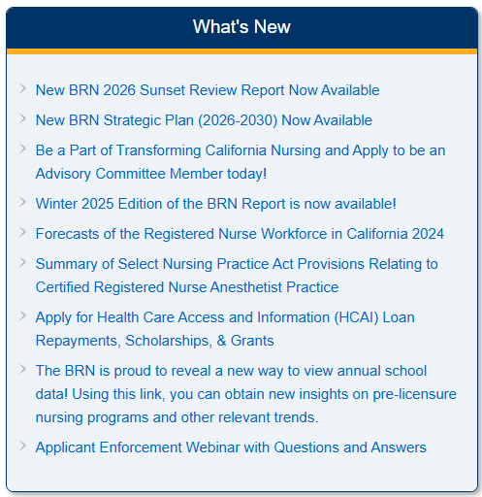

A Sampling of Sections

Slide 12
Open Educational Resources
OER

Slide 13
Open Educational Resources (OER)
PubMed Central (PMC) Full text repository of biomedical and life sciences journal articles (many nursing journals). https://www.ncbi.nlm.nih.gov/pmc/
The Directory of Open Access Journals (DOAJ) Curated index of high-quality open access journals, including nursing, public health, and allied health. https://www.doaj.org
BMC Nursing & BMC Health Services Research (BioMed Central) Open access journals with nurse-authored research. https://link.springer.com/journal/12912 https://link.springer.com/journal/12913
Public Library of Science (PLOS) Journals Open access biomedical and public health research. https://plos.org/our-journals/
National Institutes of Health (NIH) RePORTER & Research Portfolio Access to NIH-funded publications (Many nurse researchers publish here). https://reporter.nih.gov/

Slide 14
Open Educational Resources-continued
Science Open Open access article discovery platform. https://www.scienceopen.com/
Open Access Journal Platforms
Sage Open https://journals.sagepub.com/home/sgo
Wiley Online Open Access Open Access | Wiley
Springer Open https://www.springernature.com/gp/open-science/journals-books/journals
(Search within these for nursing/healthcare content)
Core—aggregates open access research from repositories and journals worldwide https://core.ac.uk/
ERIC (Education Resource Information Center) Useful for nursing education research (Not clinical but peer reviewed) https://eric.ed.gov/
Merlot Nursing OER Materials Resources developed by the California State University system https://csuoern.merlot.org/
Directory of Open Access Books https://www.doabooks.org/

Slide 15
Applications
Artificial Intelligence

Slide 16

Apps – Medical References
Epocrates (Free, Epocrates plus $16.99/month)
  Drugs
  Diseases
  Medical Diagnoses
  Treatment Plans
  Interaction Checks
  Pill Identifiers
  Clinical practice guidelines
Eponyms (1800 common medical eponyms)
  A person after whom a condition, procedure, test or classification takes its name
Pocket Prep offers a basic prep version completely free, giving nursing study sets to reinforce your learning.
Quizlet offers a space to create flashcards or use existing nursing study sets to reinforce your learning
Medscape offers comprehensive clinical reference with drug information, disease updates, and medical news.
NurseCalcs is a simple clinical calculator tailored for nurses. It helps you quickly compute medication dosages, IV Drip rates, and more.

Slide 17
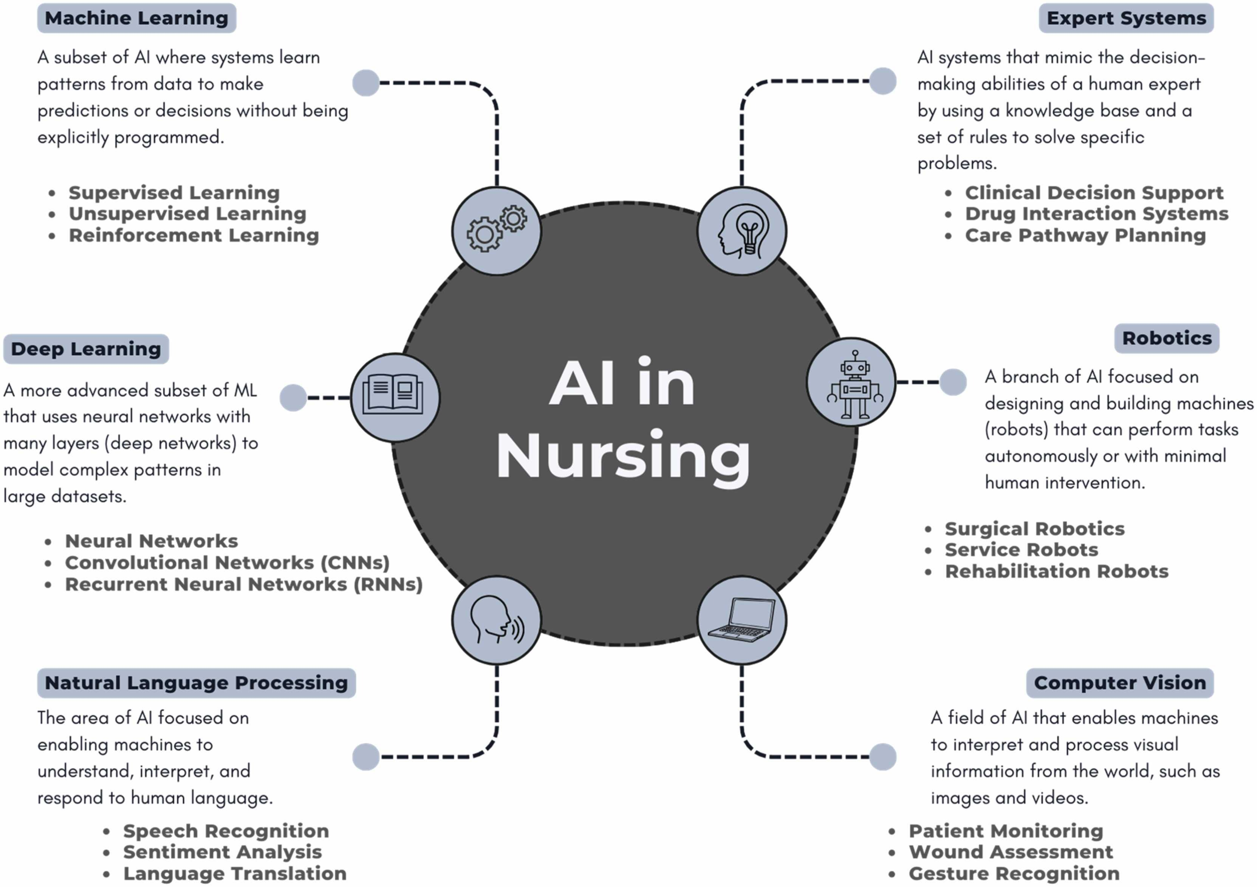
Artificial Intelligence in Nursing
“ Experts estimate that 45% of the activities that individuals are paid to perform can be automated using technology that exists today.” Chui et al. 2016; Owens et al. 2023
“ Automation powered by AI does not merely result in task completion but, under the right circumstances, can improve efficiencies, increase production rates, decrease error margins and lower costs.” Bates et al. 2021
“ By growing and enhancing its soft human skills– caring, empathy and social orientation– arguable, nursing stands to benefit from the advancement of AI.” Yakusheva et al. 2025

Slide 18
AI applications: How AI transforms nursing education
Personalized learning: AI powered systems can adapt content, pacing, and teaching strategies to meet the individual needs of each student, providing tailored support.
Enhanced simulations: AI creates realistic virtual patients and dynamic clinical scenarios allowing students to practice skills and decision making in a risk-free environment.
Skill & Decision-Making Development: through interactive learning and AI driven decision support tools, students can develop critical thinking clinical judgment and problem-solving abilities.
Administrative Support: AI can automate time-consuming tasks for educators, such as test creation, grading, and data analysis, freeing them to focus on student interaction.

Slide 19
Ethical Integration of AI
American Nursing Association Position Statement
here
Recommendations
According to the Code of Ethics for Nurses with Interpretive Statements (ANA, 2015), advanced technologies, including AI, do not replace nursing skills or judgment. The Code of Ethics for Nurses interpretive statement 4.2 clarifies that “nurses in all roles are accountable for decisions made and actions taken in the course of nursing practice. Systems and technologies that assist in clinical practice are adjunct to, not replacements for, the nurse’s knowledge and skill” (ANA, 2015, p.15). AI does not replace a nurse’s decision-making, judgment, critical thinking, or assessment skills. Interpretive statement 1.1 holds that “nurses consider the needs and respect the values of each person in every professional relationship and setting; they provide leadership in the development and implementation of changes in public and health policies that support this duty” (ANA, 2015, p.1). Nurses are responsible for being informed about and ensuring the appropriate use of AI to optimize the health and well-being of those in their care. The code specifically references concepts related to AI in the following excerpts:
As nurses, we need to recognize and call out disparities in AI programming and outputs and consider those disparities in our creation of guidelines and protocols based on AI data.
Nurses routinely work to eliminate health disparities and must intentionally engage in work that promotes diversity, equity, and inclusion in emerging technology and their associated systems-- we cannot forget the people we serve.
Mitigating bias occurs at the individual level but must be extrapolated to encompass the larger reach of technologies associated with AI.

Slide 20
AI platforms for Nursing
For Clinical Documentation and Workflow
Nurse Magic : provides on demand, HIPAA compliant AI tools to help nurses with documentation, aiming to finish tasks quickly and accurately.
Nurse Brain AI: a smart assistant that replaces paper reports with digital checklists helps organize care and can integrate with EMR systems.
Patient Notes : uses AI to convert conversations and observations into formatted clinical documentation saving nurses time on notes and integrating with EHRs.
Heidi Health: an AI tool that separates critical patient data, helps create notes in various charting styles (like DAR or PIE), and facilitates one-click integration with EHRs.

Slide 21
AI Applications for Patient interaction and care
AI Applications for learning & study
Nursify AI: an AI powered study tool specifically designed for nursing students to help them prepare for exams and learn efficiently.
Mindgrasp AI: an AI tool that transforms study materials into summaries, notes, and quizzes for nursing students, available on web and mobile.
Sensely’s Molly: A virtual nurse assistant that engages with patients, provides reminders, monitors their needs, and helps extend patient engagement outside the clinical setting.

Slide 22
Any questions?
Please do not hesitate to contact SOCHi Librarian, Marisa Tolosa
MarisaT@sochi.edu

