Slide 1


APA Formatting
Stylistics
Layout
Things to Know
References

Slide 2
Why do you have to use APA?
Because learning to write means mastering an accepted and uniform writing style.
Helps the reader locate the materials used.
Gives credit to the authors and provides a standard format of each citation.
Allow readers to focus more on your ideas by not distracting them with unfamiliar formatting.
Establish your credibility or ethos in the field by demonstrating an awareness of your audience and their needs as fellow researchers.

Slide 3
Plagiarism
Researchers do not claim the words and ideas of another as their own; they give credit where credit is due.
Quotation marks should be used to indicate the exact words of another.
Each time you paraphrase another author (i.e., summarize a passage or rearrange the order of a sentence and change some of the words), you need to credit the source in the text.

Slide 4
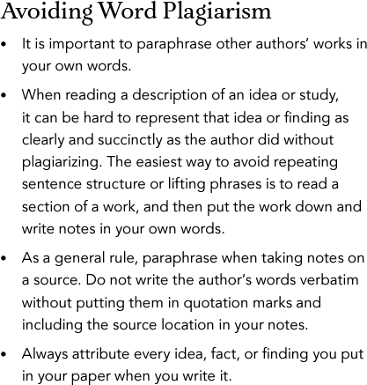

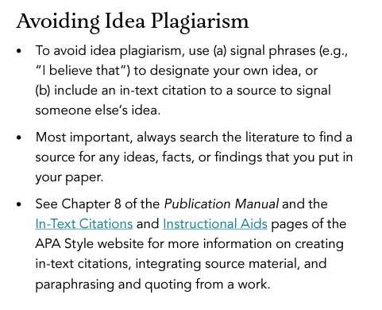

Slide 5
Stylistics
Voice
  Describes the relationship between a verb and the subject and object associated with it.
⯍ Active Voice- the subject of a sentence is presented first, followed by the verb and then the object of the verb (e.g., “students completed surveys”).
⯍ Passive Voice- the object of the verb is presented first, followed by the verb and then the subject last (e.g., “surveys were completed by students”)
  APA Style encourages using the active voice as it creates direct, clear, and concise sentences.

Slide 6
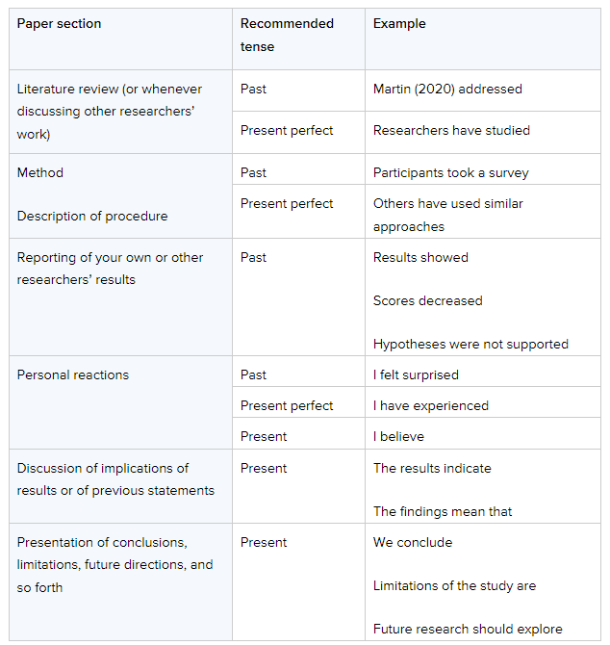
Recommended Verb Tenses

Slide 7
Stylistics
Clarity and Conciseness
  Clarity and conciseness in writing are important when conveying research in APA Style. You don't want to misrepresent the details of a study or confuse your readers with wordiness or unnecessarily complex sentences.
  For clarity, be specific rather than vague in descriptions and explanations. Unpack details accurately to provide adequate information to your readers so they can follow the development of your study.
Economy of Expression
Say only what needs to be said in your writing: The author who is more concise—writes a more readable paper.

Slide 8
Word Choice
Use terms like "participants" or "respondents" (rather than "subjects") to indicate how individuals were involved in your research
Use terms like "children" or "community members" to provide more detail about who was participating in the study
Use phrases like "The evidence suggests ..." or "Our study indicates ..." rather than referring to "proof" or "proves" because no single study can prove a theory or hypothesis

Slide 9
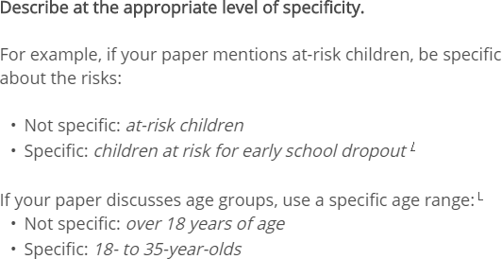

Reducing Bias in Language

Slide 10
Layout
Basic Setup
Title Page
Quotations
Headings

Slide 11

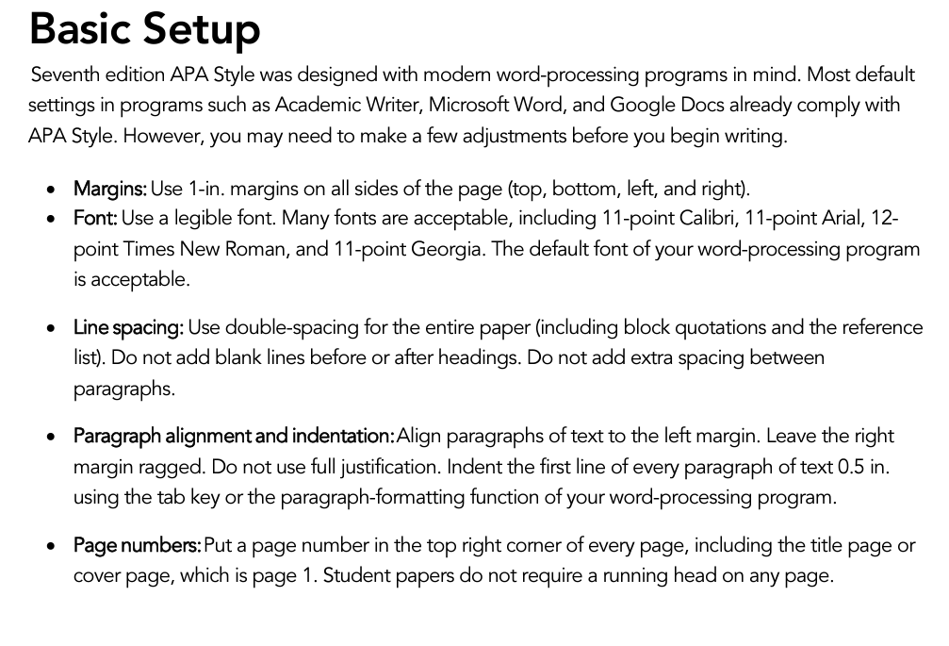

Slide 12

What will you include ?
Title page with page numbers
Lines that are double spaced
1 inch margins on all sides
Times New Roman 12-point font (suggested font) Headings (per instructor guidelines)
Citations
References page

Slide 13
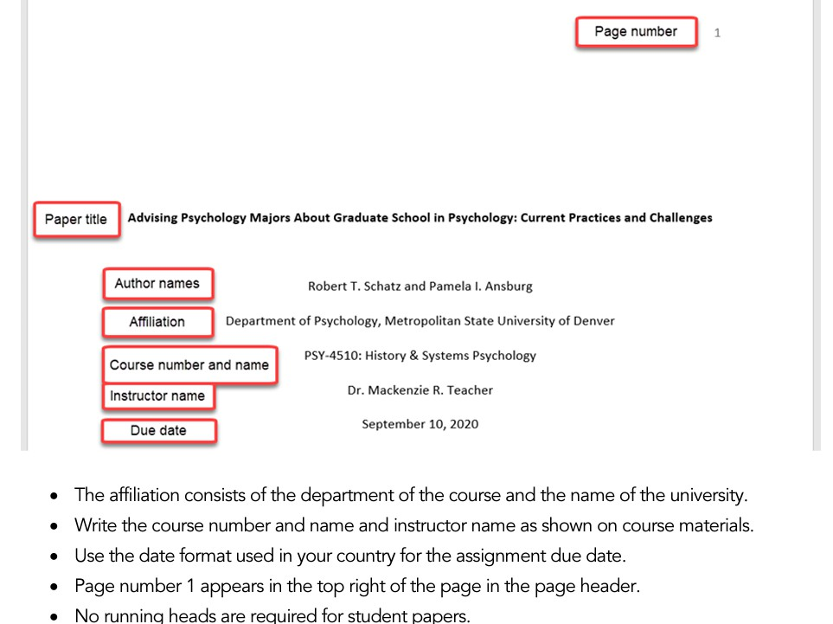
Title Page Elements

Slide 14
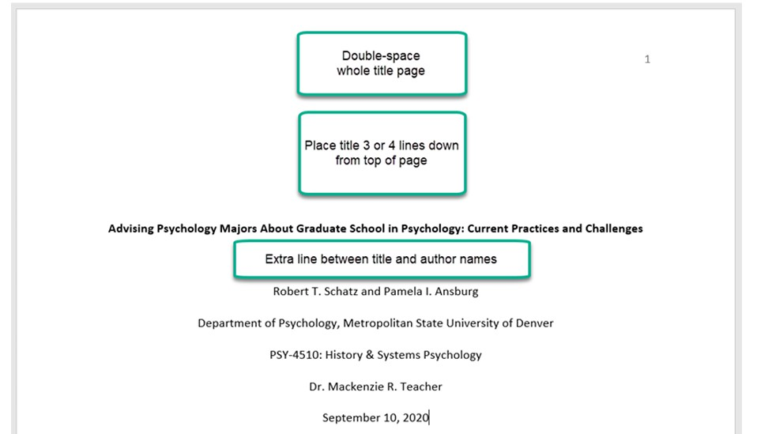
Title Page Line Spacing

Slide 15
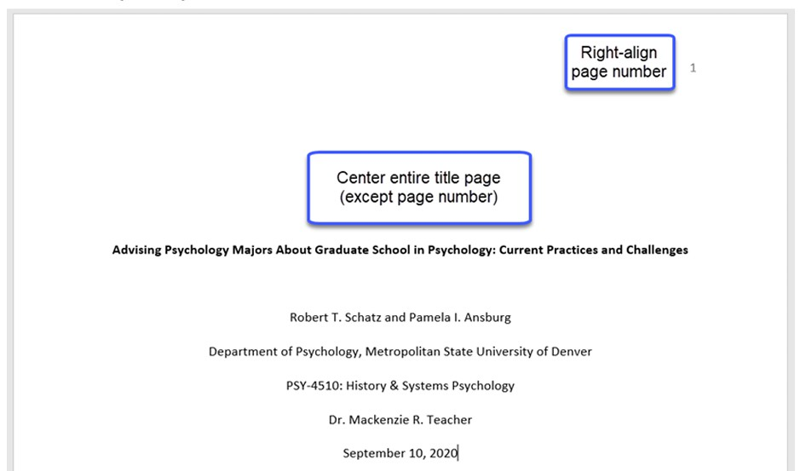
Title Page Alignment

Slide 16
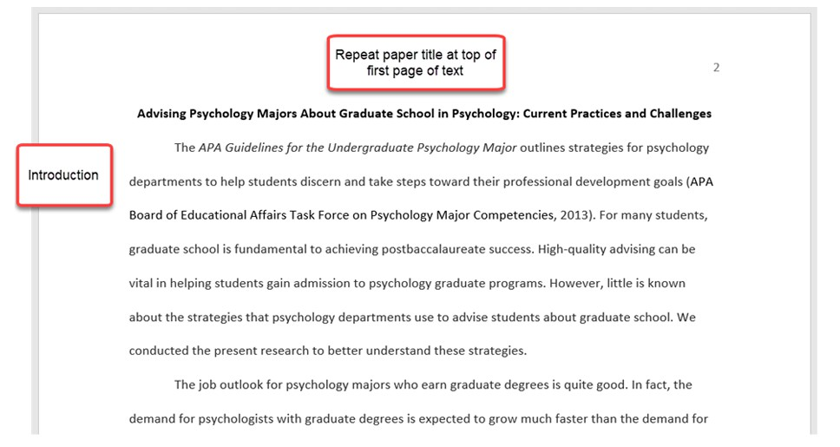
Text Elements
“Introduction” should not be a heading

Slide 17

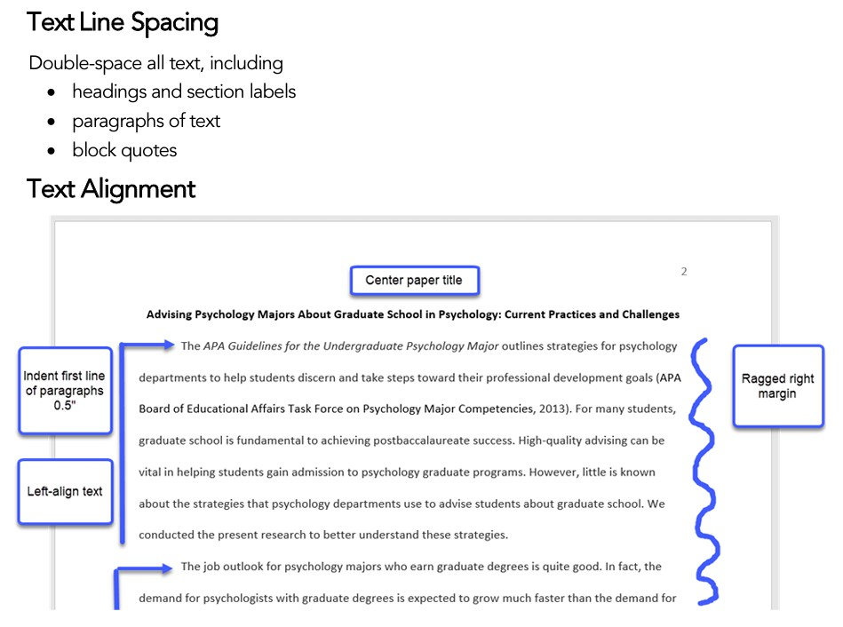

Slide 18
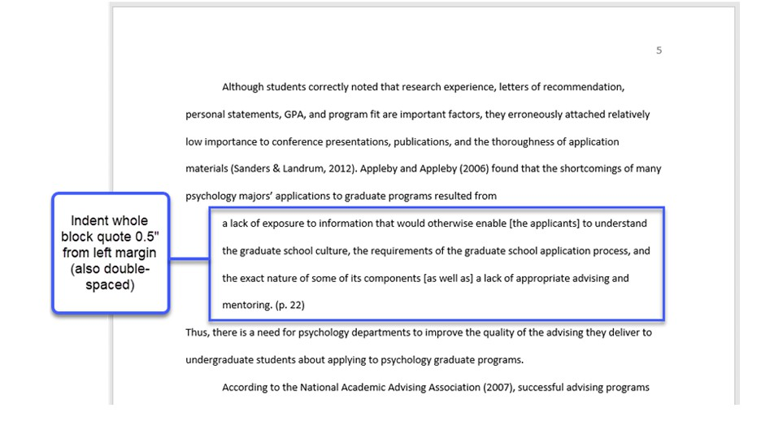
Block Quotation Alignment

Slide 19
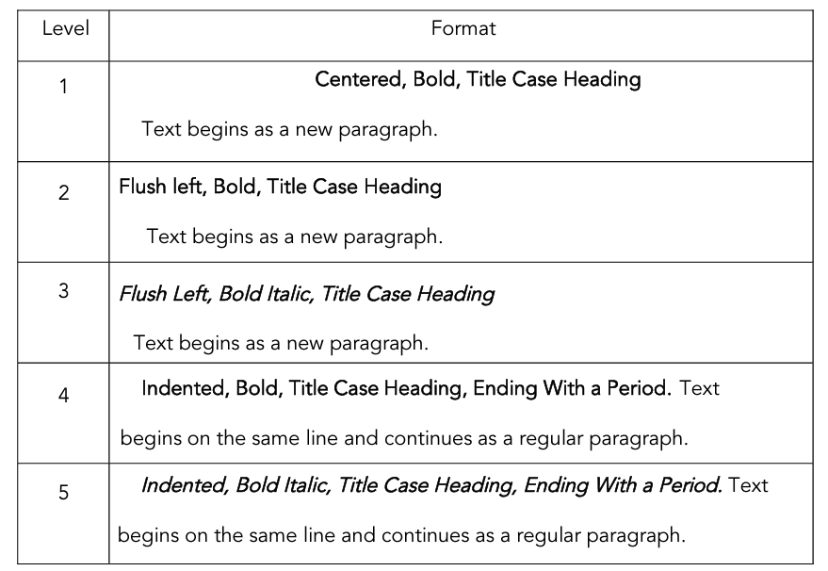
Headings Format
All topics of equal importance have the same level of heading throughout the manuscript.
Level 2 are subsections of Level 1, and so on.

Slide 20
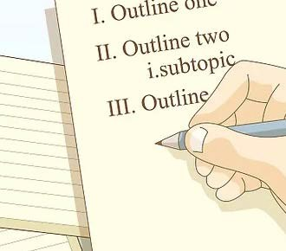
HOT TIP
Writing From an Outline
Ensures that the flow of your paper reflects the logic of your research or ideas.
Helps to:
  Identify main ideas
  Define subordinate ideas
  Focus your writing
  Avoid tangential excursions
  Find omissions
Helps to designate headings and subheadings you will use in you paper
Helps to ensure that your grading rubric and your paper meet all the required elements

Slide 21
Things to Know
Numbers
Parentheses
Abbreviations
In-text citations
Citation Formatting

Slide 22
Numbers
Numbers Expressed in Words
Examples
In general, use words to express numbers zero through nine, and use numerals to express numbers 10 and above.
there were five nurses on duty
the study had three conditions
students were in the third, sixth, eighth, 10th, and 12th grades

Slide 23
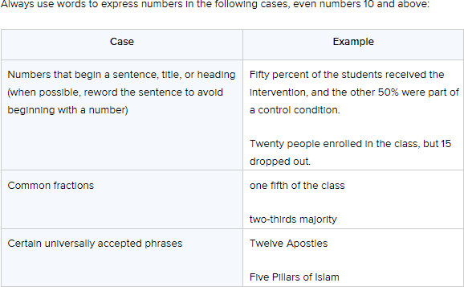
Cases in which to always use words for numbers

Slide 24
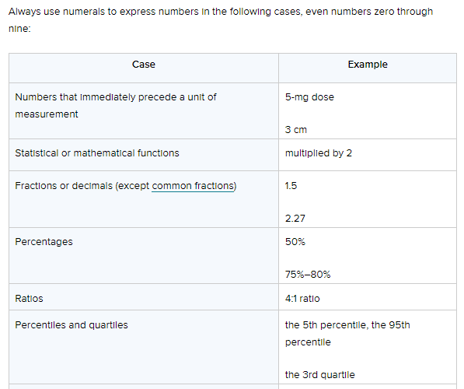
Cases in which to always use numerals for numbers
More

Slide 25
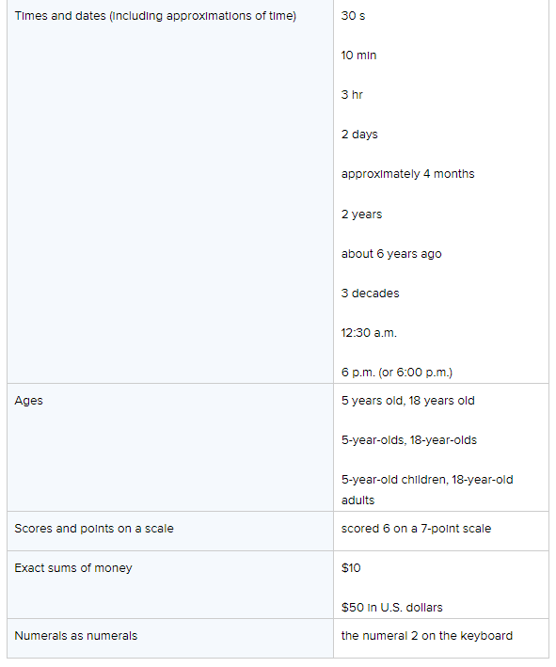
Cases in which to always use numerals for numbers

Slide 26
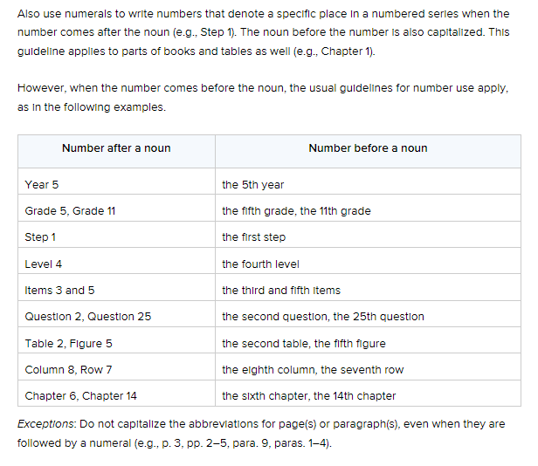
Numbers in a series

Slide 27
Parentheses
Use parentheses to set off structurally independent elements
Examples:
The patterns were significant (see Figure 5).
(When a complete sentence is enclosed in parentheses, place punctuation in the sentence inside the parentheses, like this.)
If only part of a sentence is enclosed in parentheses (like this), place punctuation outside the parentheses (like this).

Slide 28
Abbreviations
When abbreviating a term, use the full term the first time you use it, followed immediately by the abbreviation in parentheses.
According to the American Psychological Association (APA), abbreviations are best used only when they allow for clear communication with the audience.
Exceptions: Standard abbreviations like units of measurement and states do not need to be written out. APA also allows abbreviations that appear as words in Merriam-Webster’s Collegiate Dictionary to be used without explanation (IQ, REM, AIDS, HIV).

Slide 29
Abbreviations
Do not use periods or spaces in abbreviations of all capital letters, unless it is a proper name or refers to participants using identity-concealing labels:
MA, CD, HTML, APA
P. D. James, J. R. R. Tolkien, E. B. White or F.I.M., S.W.F.

Slide 30

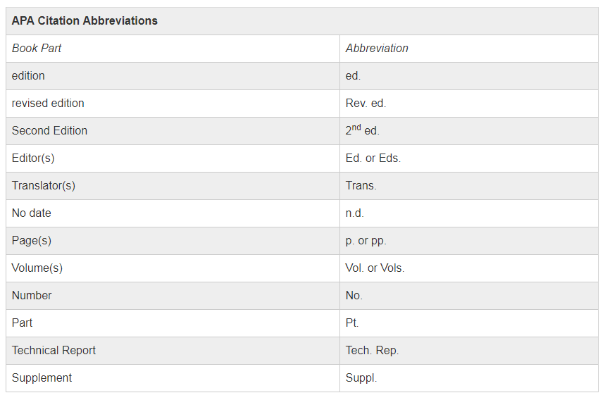
APA Citation Abbreviations

Slide 31
Job Titles and Positions
Capitalize a job title or position when the title precedes a name:
  Registered Nurse Paul T. Lo
  Nurse Lo
  Executive Director of Marketing Carolina Espinoza led the meeting.
Do not capitalize a job title or position when the title follows the name or refers to a position in general:
  nurse, registered nurse, advanced practice nurse, nurse practitioner
  Carolina Espinoza, executive director of marketing, led the meeting.

Slide 32
Diseases, Disorders, Therapies, and Related Terms
Do not capitalize the following:
  autism spectrum disorder
  major depression
  diabetes
  leukemia
  cognitive behavior therapy
  applied behavior analysis
  immunotherapy
Capitalize personal names that appear within the names of diseases, disorders, therapies, treatments, theories, concepts, hypotheses, principles, models, and statistical procedures.
  Alzheimer’s disease
  non-Hodgkin’s lymphoma
  Down syndrome
  Freudian theory

Slide 33
Appropriate Level of Citation
Cite the work of those individuals whose ideas, theories, or research have directly influenced your work.
Cite primary sources when possible and secondary sources sparingly. Both paraphrases and direct quotations require citations.
For most papers, cite one or two of the most representative sources for each key point.

Slide 34
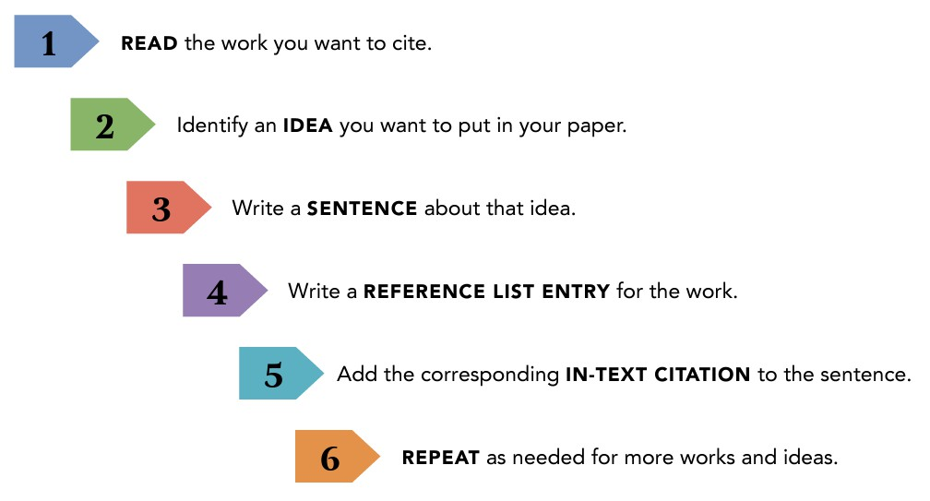
Six Steps to Proper Citation Infographic

Slide 35
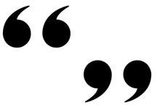
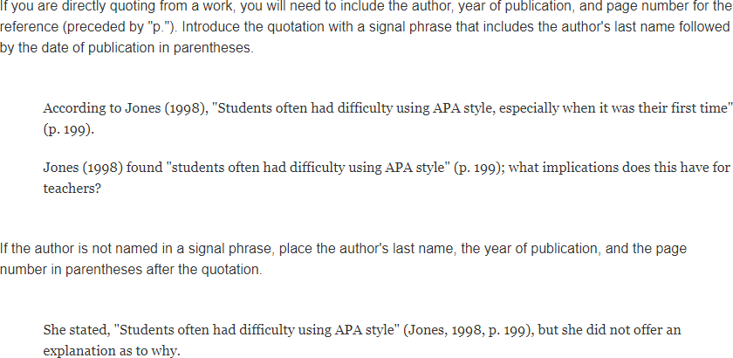
Short Quotations
If the author is part of the narrative:
Standard in-text citation:

Slide 36
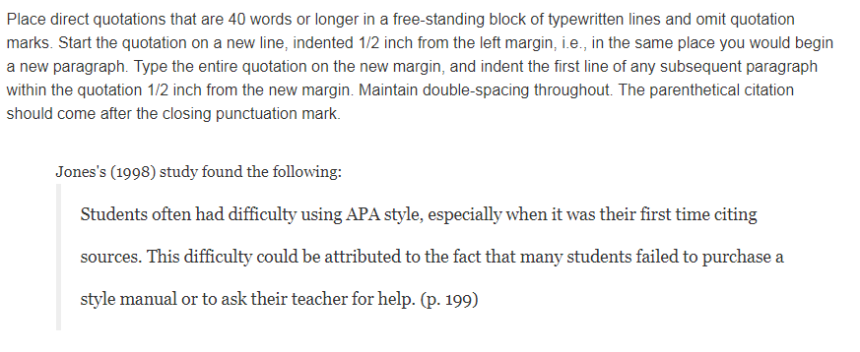
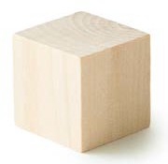
Long Quotations (40 words or longer)

Slide 37

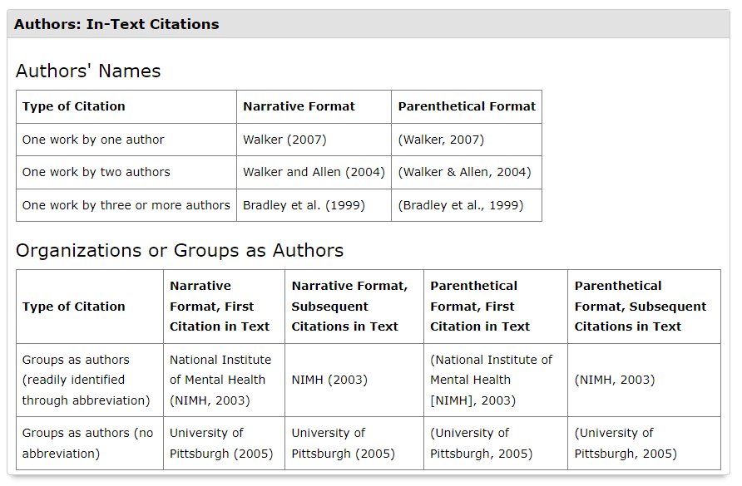
Basic In-Text Citation Styles

Slide 38

When citing a secondary source, provide a reference list entry for the secondary source that you used.
In the text, identify the primary source and then write “as cited in” the secondary source that you used.
For example, if you read a work by Lyon et al. (2014) in which Rabbit (1982) was cited, and you were unable to read Rabbitt’s work for your self, cite Rabbitt’s work as the original source, followed by Lyon et al.’s work as the secondary source.
Only Lyon et al.’s work appears in the reference list.
(Rabbit, 1982, as cited in Lyon et al., 2014)
Secondary Resources
A primary source presents information gathered firsthand, such as the results of an experiment or data from a survey.
Secondary sources present information secondhand—an example would be a textbook summary of a topic or a Wikipedia article. APA recommends citing primary sources whenever possible, because this allows you to verify the accuracy and completeness of the information yourself rather than rely on someone else to do this for you.

Slide 39

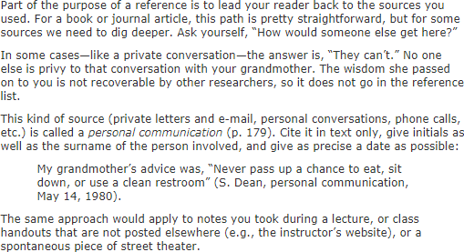


Personal Communication
Cite in text only, give initials as well as the surname of the person involved, and give as precise a date as possible.

Slide 40
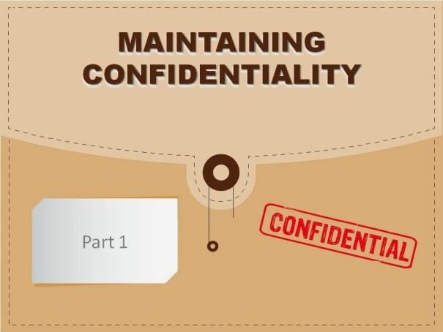
Research Interviews
Qualitative Data: Part of the research on which you are reporting that does not constitute the work of others. Example: Participants you interview in your own research.
They should never be individually cited or treated as personal communications in APA Style, because this could compromise confidentiality.
How then should you handle the need to quote from participant interviews? Some authors quote participants without distinguishing them at all, like this: “Indeed, a comment by one of our participants illustrates some of these complex issues: [quote follows without other attribution].”
Others identify participants by demographic or other data: “At my age I think we know who we are and what we are. (Female participant, 69 years of age).”
You can also identify participants with letters (Participant A, Participant B), nicknames (Sonny, Tracey), or by role (Doctor, Patient).

Slide 41
References
Reference List Formatting
Reference Examples
APA Resources
Google Tip

Slide 42

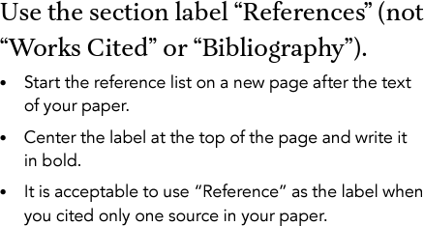
Reference List

Slide 43
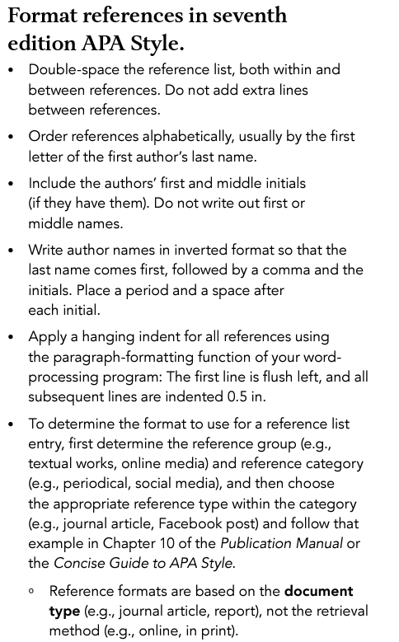
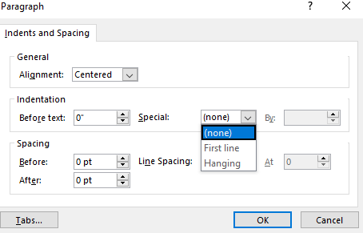
Format References
All of these points are important.

Slide 44









Reference List Basic Rules-Journal Article

Slide 45
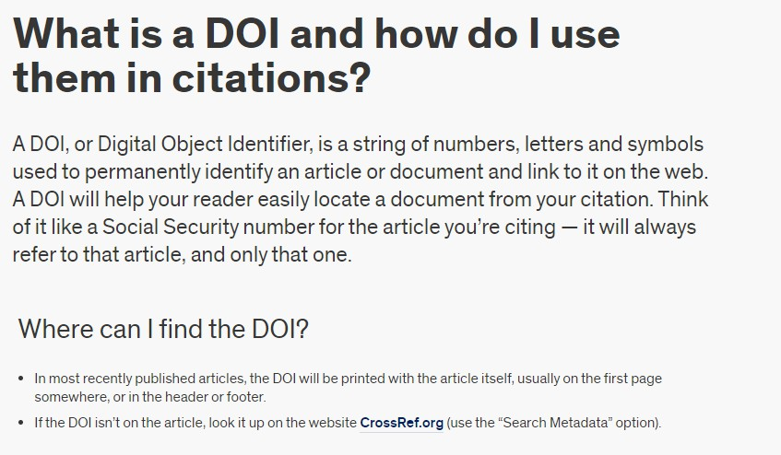
DOI

Slide 46





Reference List Basic Rules - Book

Slide 47
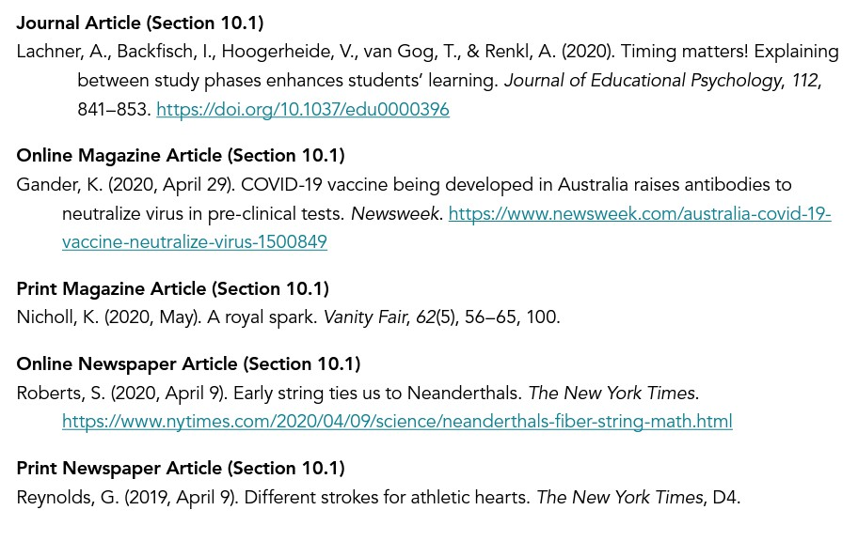
Other Reference Examples

Slide 48
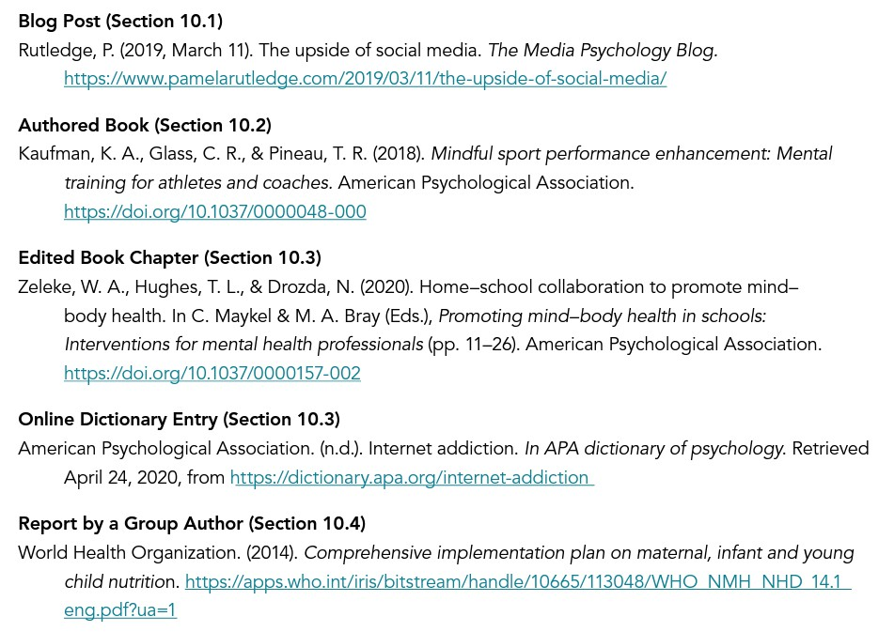

Slide 49
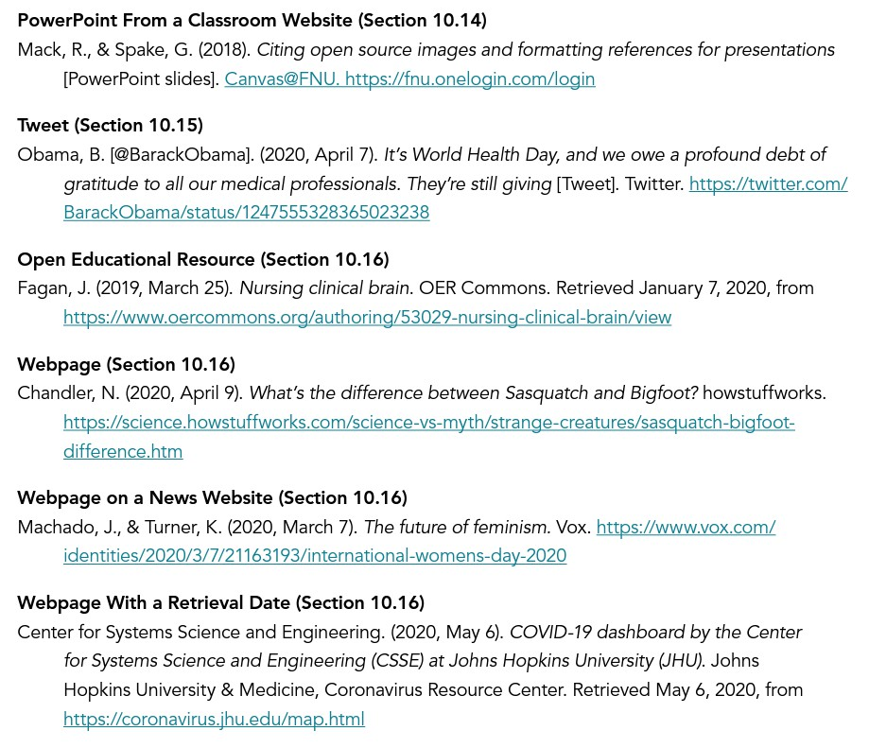

Slide 50
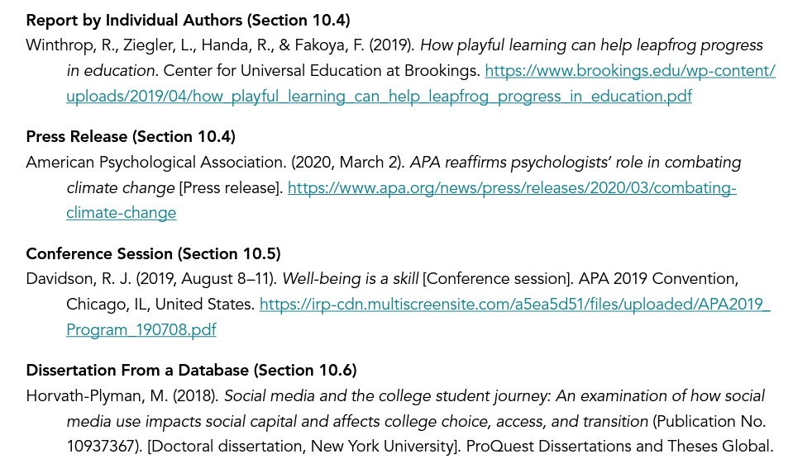

https://apastyle.apa.org/style-grammar-guidelines/references/examples

Slide 51
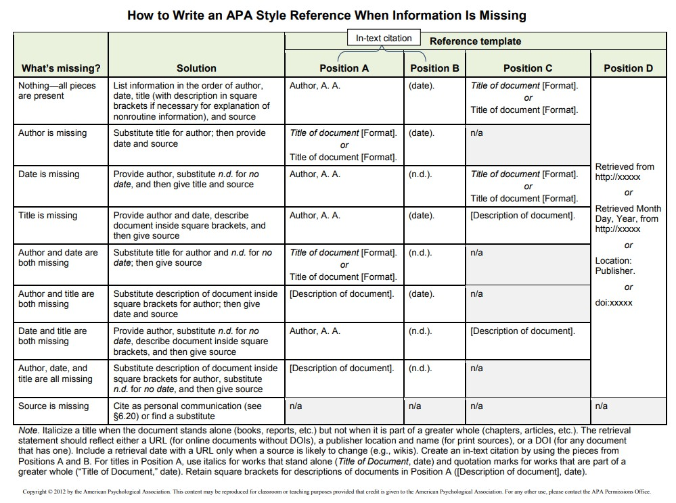

Slide 52
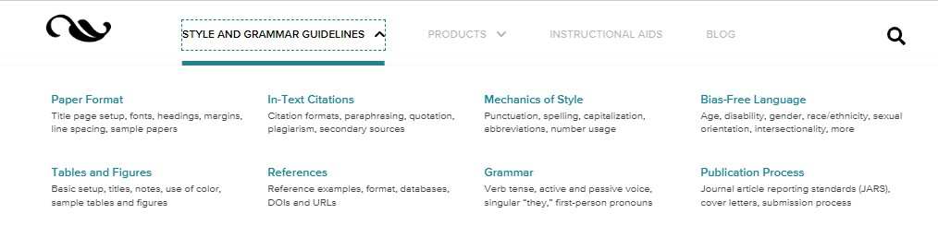
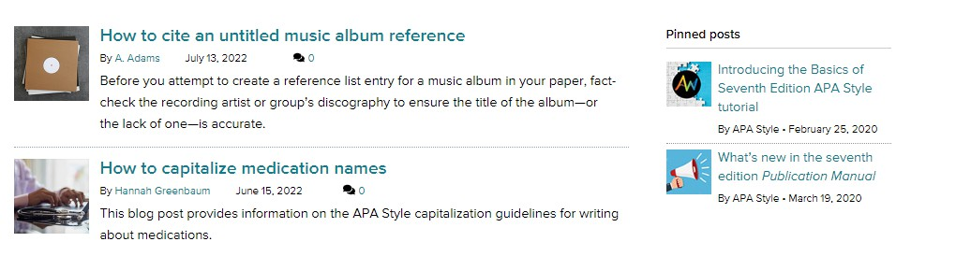
APA Resources
APAstyle.apa.org
APAstyle.apa.org/blog

Slide 53

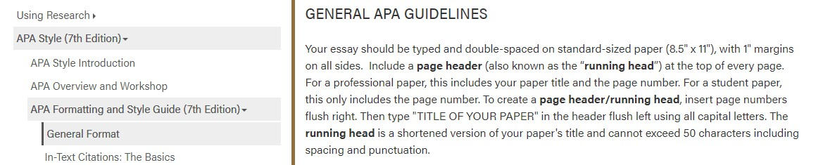
APA Resources
https://owl.purdue.edu/owl/research_and_citation/apa_style/apa_formatting_and_s tyle_guide/general_format.html

Slide 54
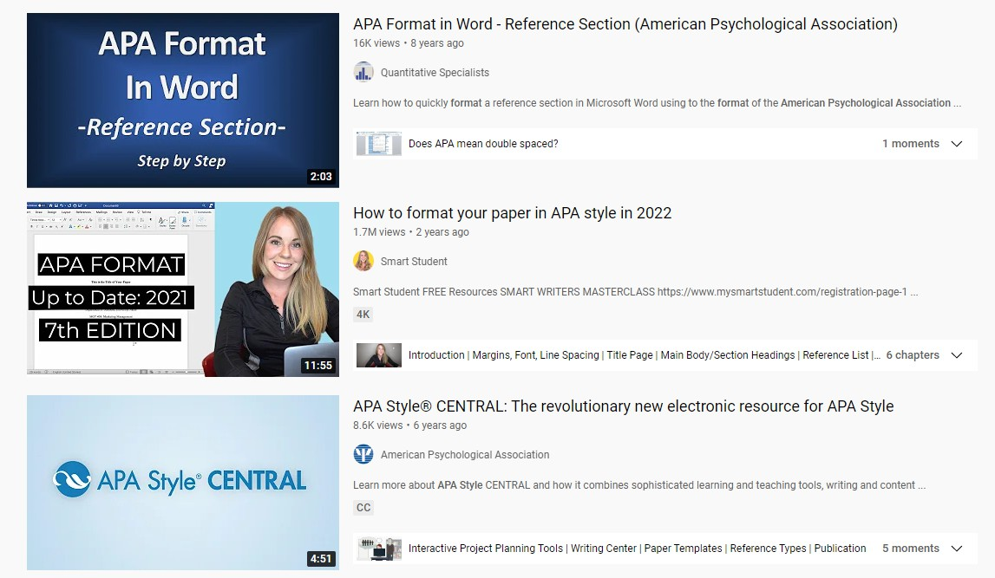
APA Resources - YouTube

Slide 55
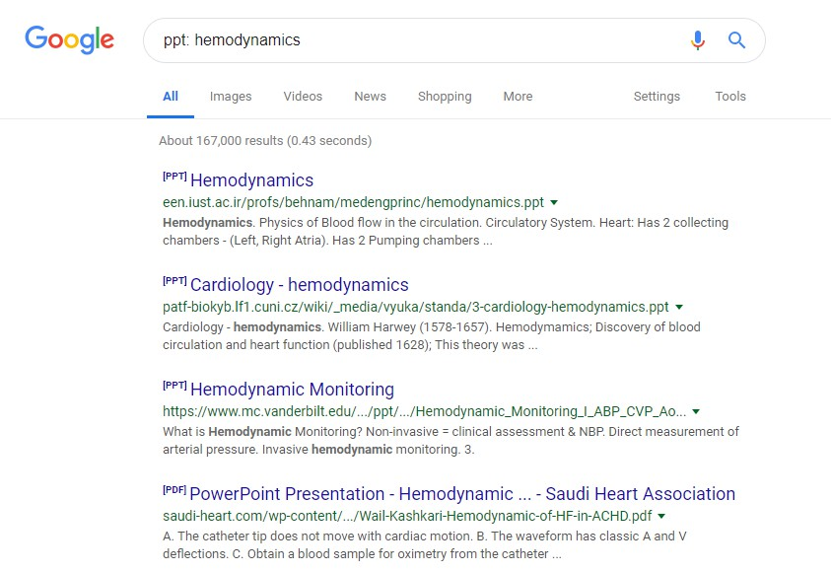
Final Hot Tip- Google
When searching in Google you may use a 3-letter identifier followed by a colon and your search terms.
Results will include that format.
Works for: .ppt,
.xcl, .doc, .jpeg,
.pdf, etc.
Also, for sites:
.edu, .org

Slide 56

Thank You
Please email MarisaT@sochi.edu with any questions or concerns
Sources used for this presentation include (Not in APA format ☺):
https://www.apastyle.org/ https://blog.apastyle.org/ https://owl.purdue.edu/
https://www.youtube.com/results?search_query=apa+format
American Psychological Association. (2020). Publication manual of the American Psychological Association (7th ed.). Washington, DC: American Psychological Association.
American Psychological Association. (2005). Concise Rules of APA Style.
Washington, DC: American Psychological Association.

